Slide 1
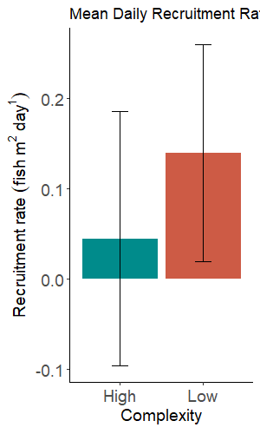
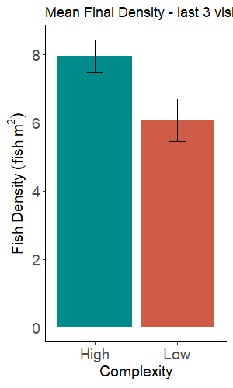
Notes:
16N – 8 H, 8 L
*control plots

Slide 2
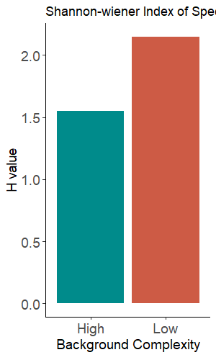
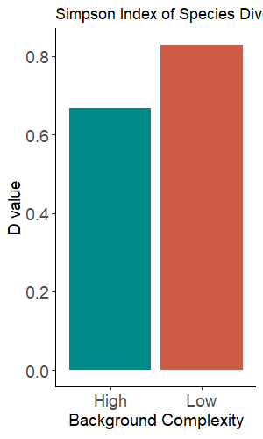
Notes:
* Whole study period

Slide 3
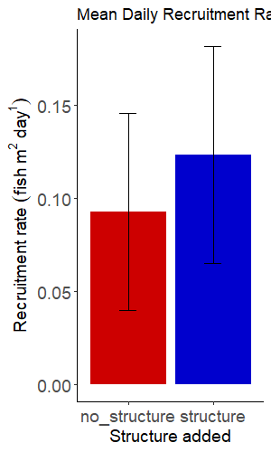
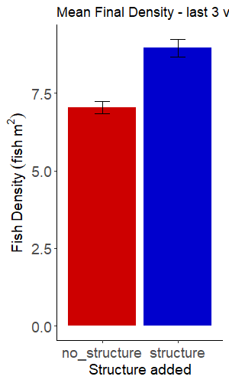
Notes:
*unbalanced → analysis
16 no structure, 80 structure

Slide 4
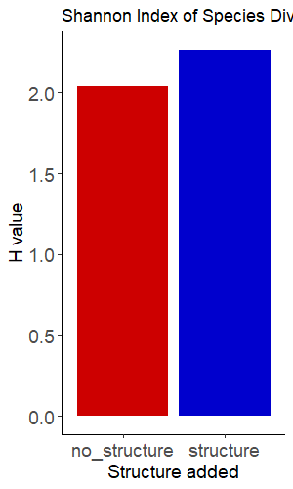
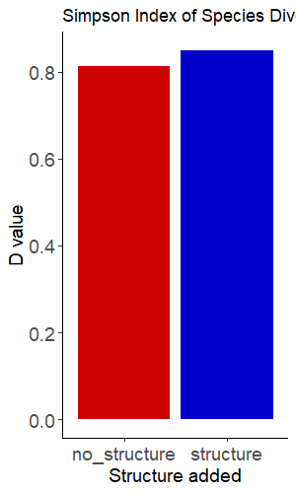

Slide 5
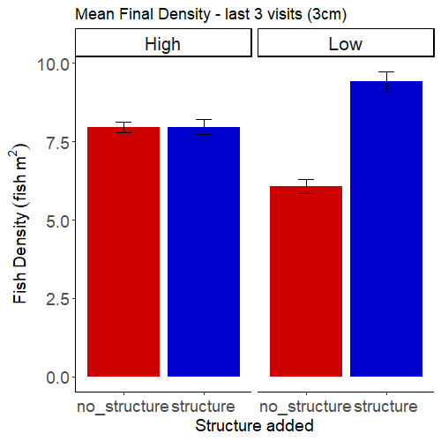
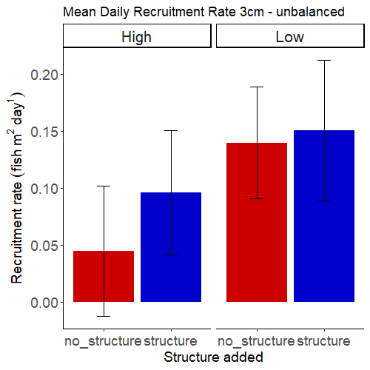

Slide 6
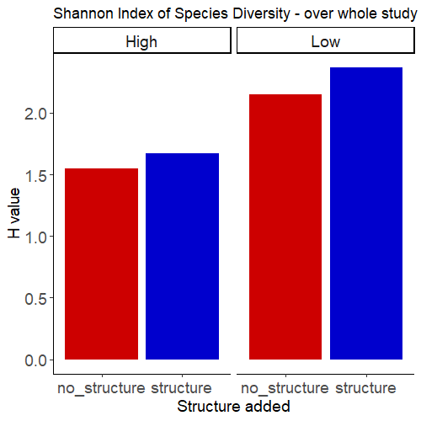
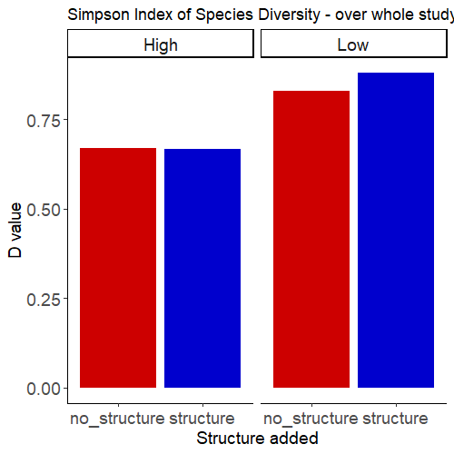

Slide 7
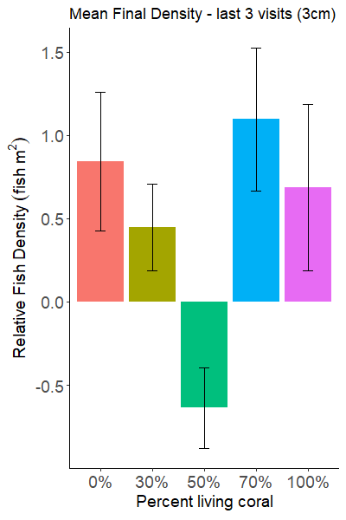
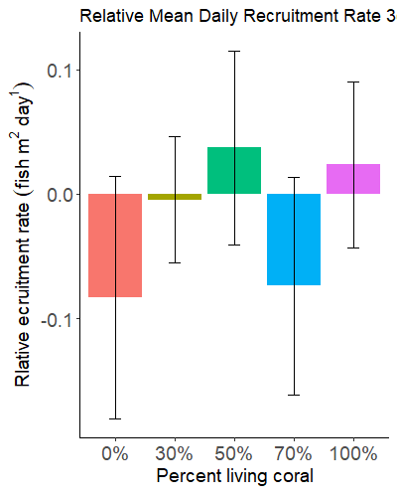

Slide 8
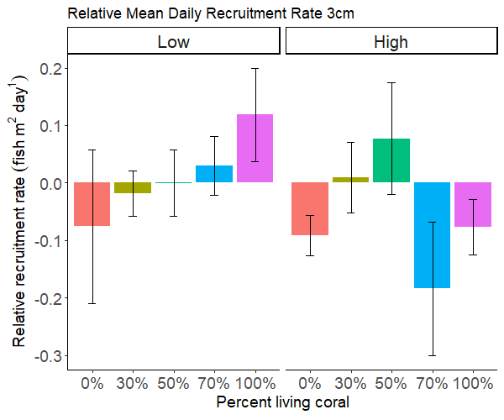
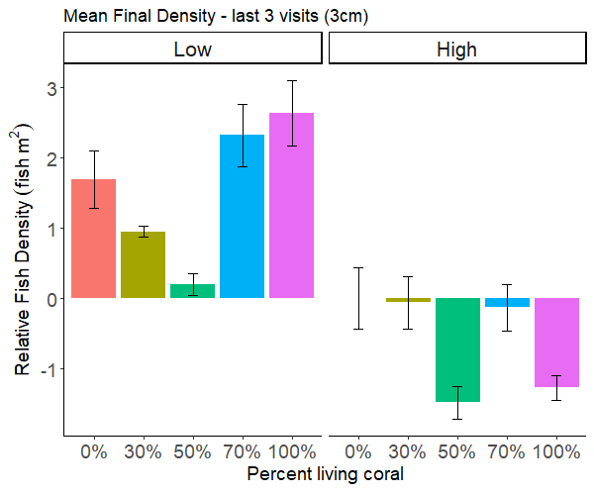

Slide 9
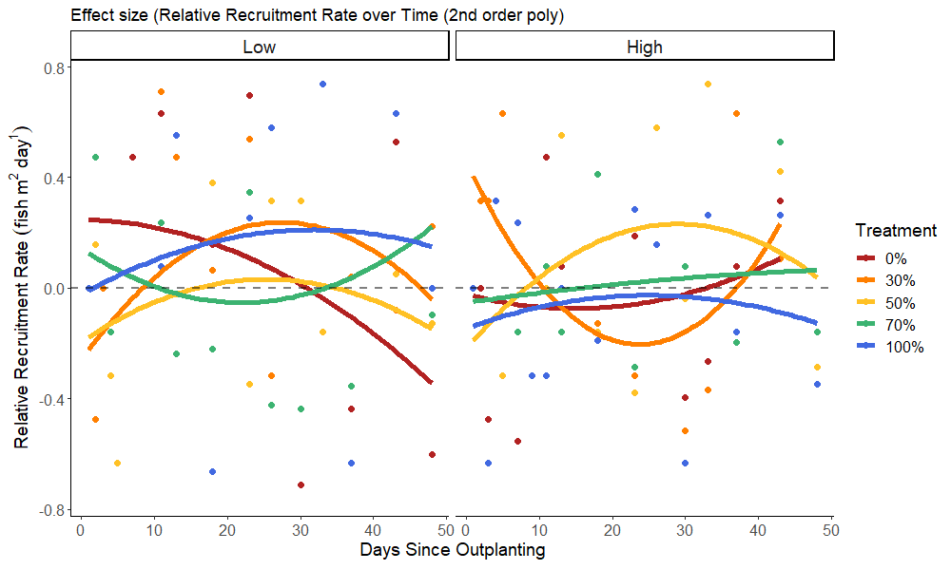
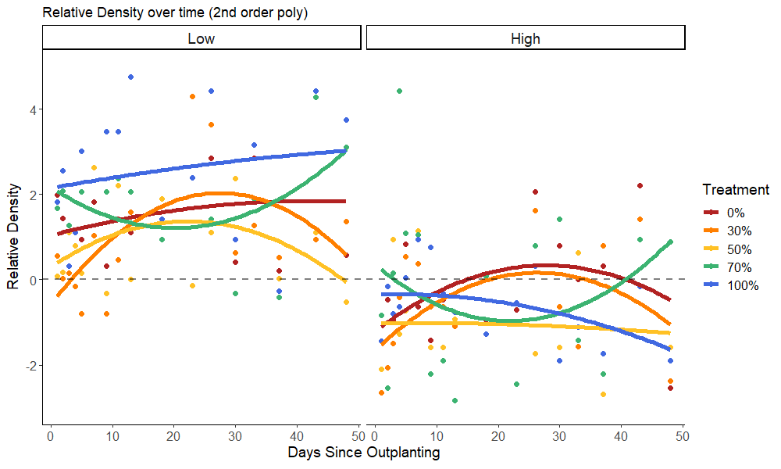
Notes:
*actual density vs relative

Slide 10
Background Complexity
Added Structure
Structural Composition
Inferred Recruitment:
Recruitment rate
Inferred Retention:
Final Density
Diversity :
Shannon / Simpson

Slide 11
All fish
Trait/Trophic group 1 …
Trait/Trophic group 2 …
Inferred Recruitment:
Recruitment rate
Inferred Retention:
Final Density

